Slide 1
Chapter 18

Slide 2
Objectives

Slide 3
Objectives (cont.)

Slide 4
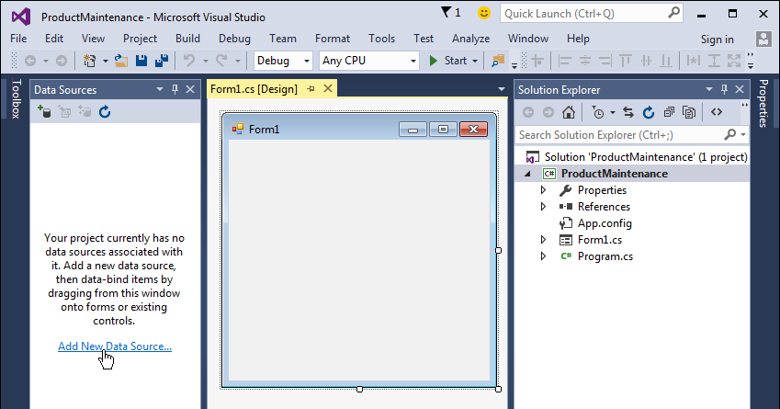
An empty Data Sources window

Slide 5
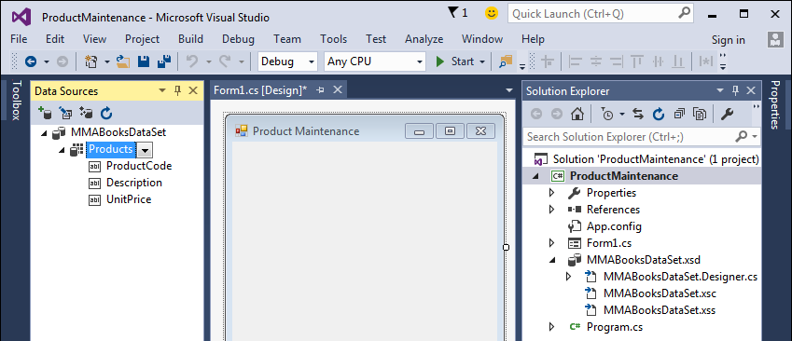
A Data Sources window after a data source has been added

Slide 6
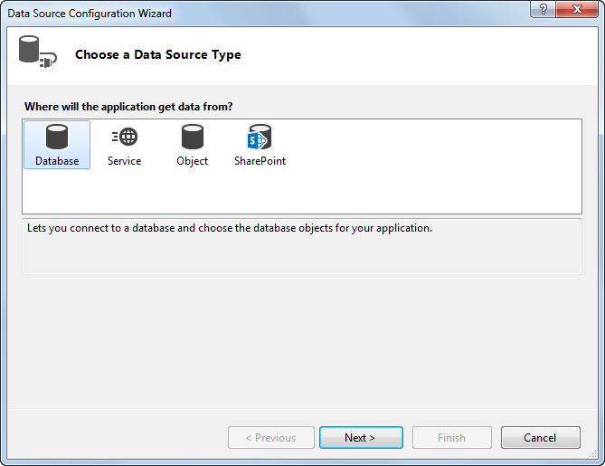
The Data Source Configuration Wizard: Step 1

Slide 7
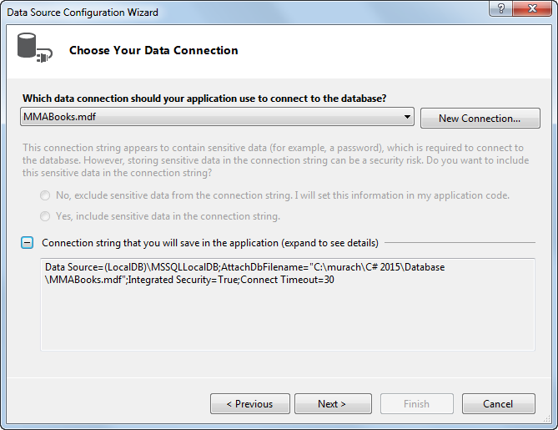
The Data Source Configuration Wizard: Step 2

Slide 8
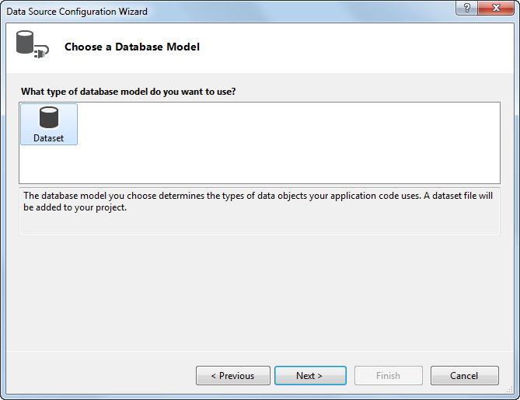
The Data Source Configuration Wizard: Step 3

Slide 9
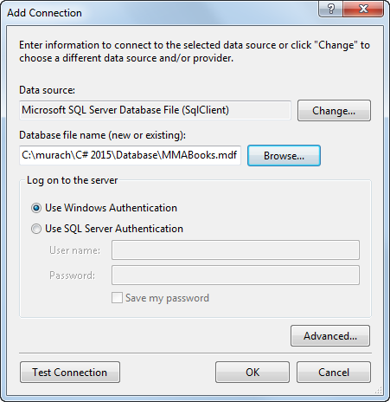
The Add Connection dialog box

Slide 10
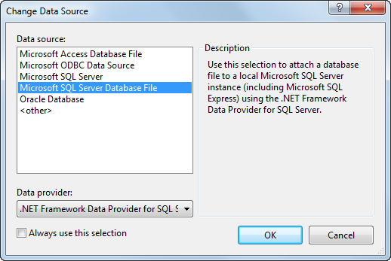
The Change Data Source dialog box

Slide 11
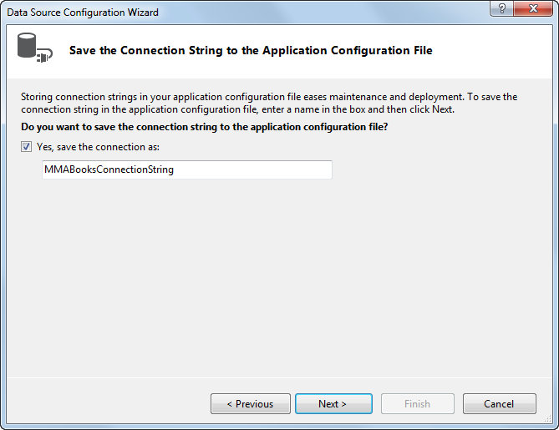
The Data Source Configuration Wizard: Step 4

Slide 12
The information that’s stored in the app.config file

Slide 13
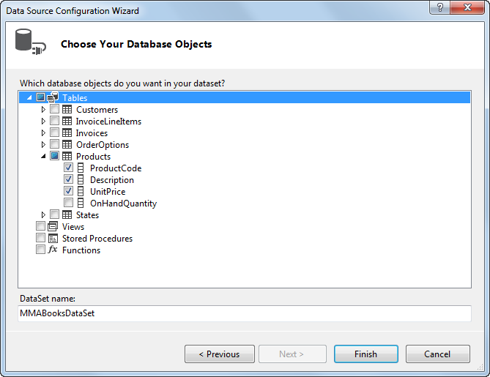
The Data Source Configuration Wizard: Step 5

Slide 14
How to work with columns that have default values

Slide 15
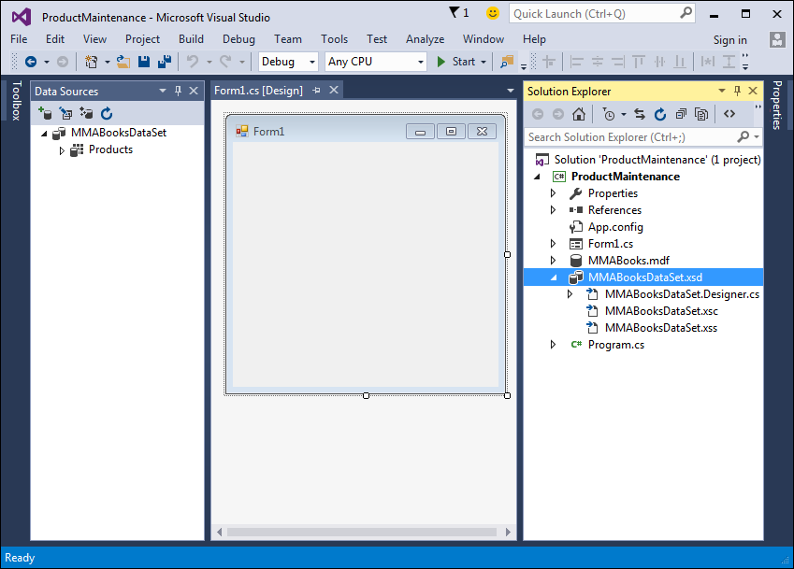
A project with a dataset defined by a data source

Slide 16
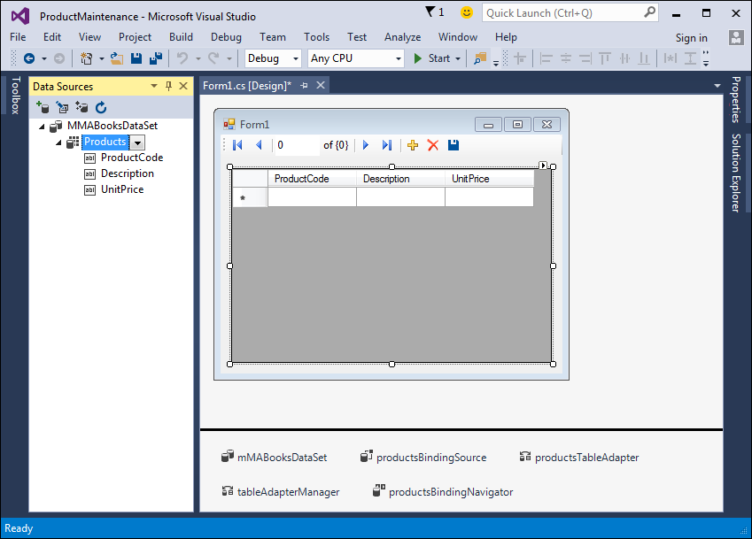
A form with the Products table dragged onto it

Slide 17
The controls and objects that are created when you drag a data source to a form

Slide 18
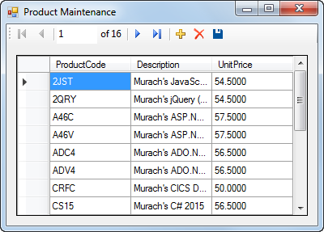
The user interface for the Product Maintenance application

Slide 19
The code that’s generated by Visual Studio

Slide 20
The syntax of the Fill method

Slide 21
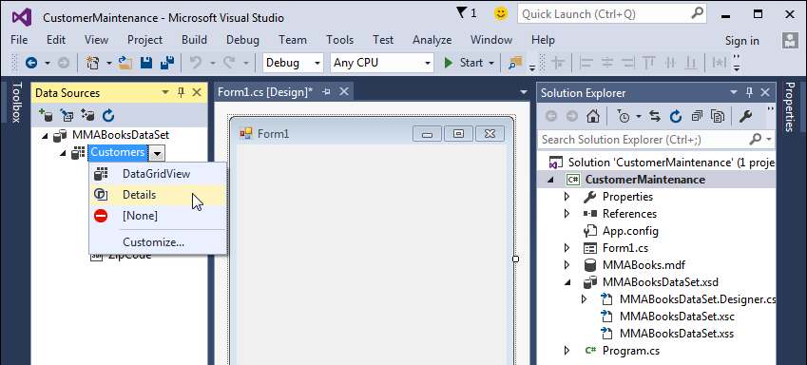
How to change the default control for a data table

Slide 22
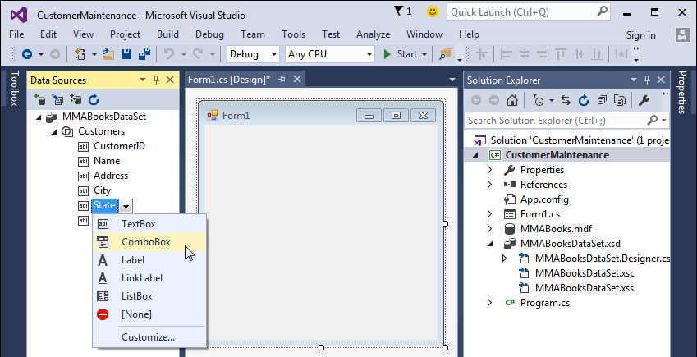
How to change the default control for a column in a data table

Slide 23
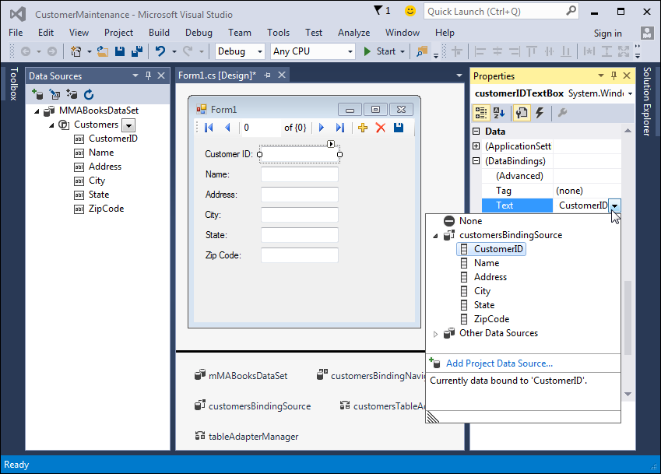
A form with the Customers table dragged onto it

Slide 24
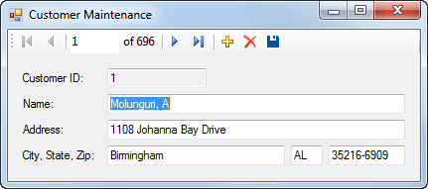
The user interface for the Customer Maintenance application

Slide 25
The code for the application

Slide 26
.NET data provider exception classes

Slide 27
Common members of the .NET data provider exception classes

Slide 28
Code that catches a SQL exception

Slide 29
Common ADO.NET exception classes

Slide 30
Code that handles ADO.NET errors

Slide 31
An event of the DataGridView control

Slide 32
Code that handles a data error for a DataGridView control

Slide 33
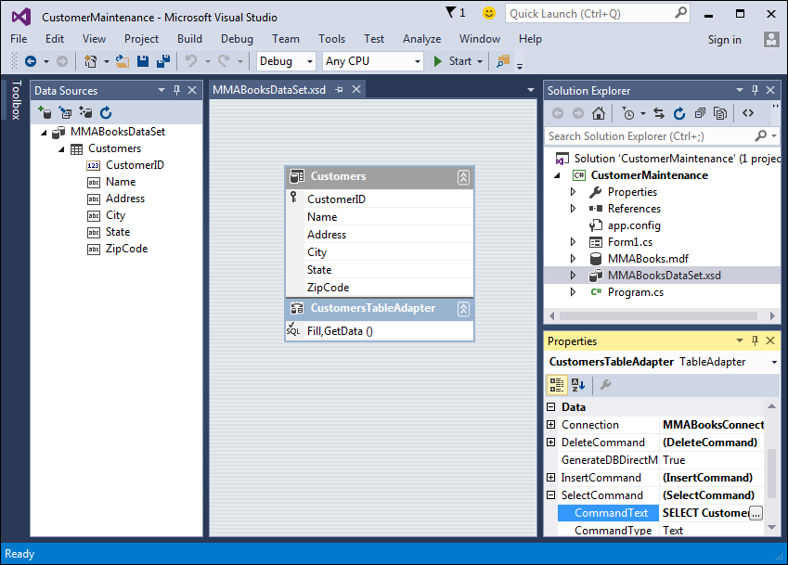
The schema displayed in the Dataset Designer

Slide 34
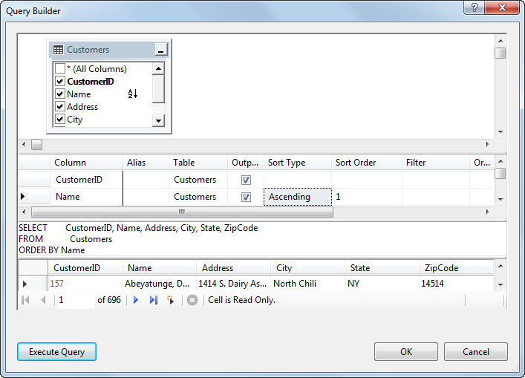
The Query Builder

Slide 35
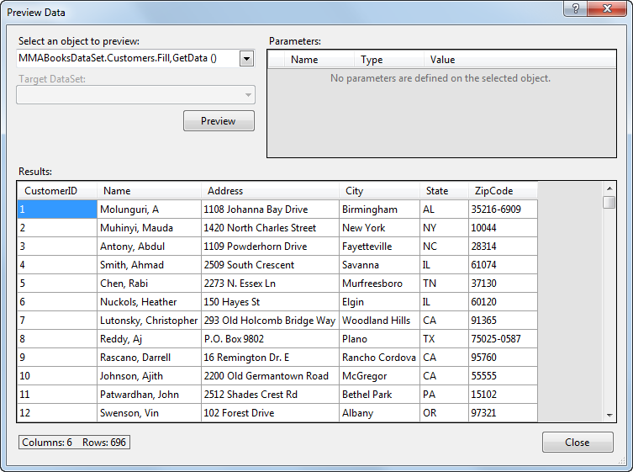
The Preview Data dialog box

Slide 36
SQL that retrieves customer rows

Slide 37
SQL that updates a customer row and refreshes the dataset

Slide 38
SQL that deletes a customer row

Slide 39
Extra 18-1 Create a State Maintenance application

Slide 40
Extra 18-2 Create a Product Maintenance application

Slide 41
Project 4-1 Maintain products

Slide 42
Project 4-2 Maintain technicians

